Slide 1

PACKET TRACER TRAFFIC
MANAGEMENT SYSTEM
TRAFFIC LIGHT
DONE BY : Malak Yazbek
2025

Slide 2
TRAFFIC LIGHT
Smart Street Monitoring and Traffic Management System
Using IoT and Cisco Packet Tracer
It combines sensors, automation, alerts, and networking to improve safety and efficiency.
The system is scalable and suitable for future smart city applications.
2025

Slide 3
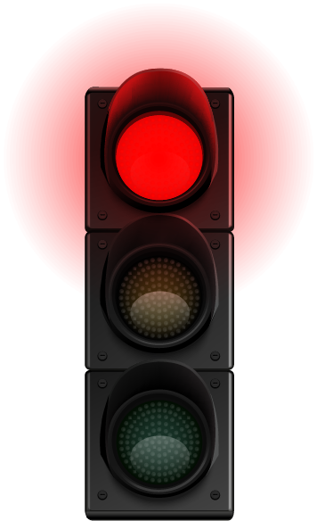
Advantages
TRAFFIC LIGHT
Improves pedestrian safety
Reduces traffic confusion
Automatic and smart control
Supports visually impaired people
Can be expanded to real smart cities
2025

Slide 4
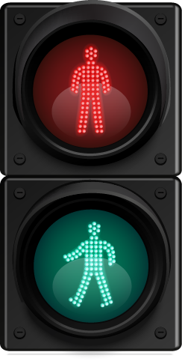
INTRODUCTION
TRAFFIC LIGHT
Traffic safety and pedestrian protection are important in smart cities.
This project simulates a smart street system using motion sensors, RGB lights, LCD, buzzer, camera, and network devices in Cisco Packet Tracer.
The system automatically detects people and cars and reacts in real time.
2025

Slide 5
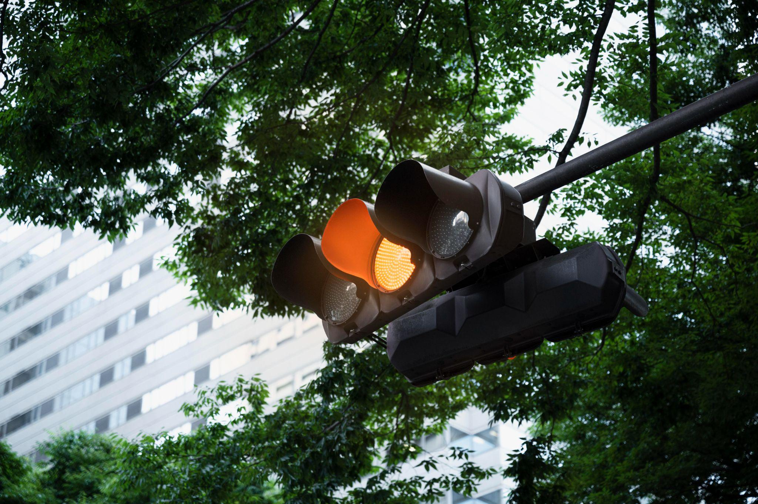
Project Objectives
Detect people movement and car movement
Control traffic lights automatically
Improve pedestrian safety
Provide visual and sound alerts
Send street data to server and laptop
Demonstrate IoT and networking concepts

Slide 6
System Overview
Two motion sensors ( People & Cars )
Two RGB traffic lights
One LCD screen
Buzzer for alerts
Webcam for street monitoring
SBC controller for processing
Wi-Fi router, server, and laptop for data access
All devices are connected and controlled automatically.

Slide 7

What every element serve?
Motion Sensors
LCD
Display
People Motion Sensor detects pedestrians
Car Motion Sensor detects vehicles
Sensors send signals to the SBC controller
Only one type of movement is active at a time
The LCD shows real - time street status :
  Waiting
  People Moving
  Cars Moving
  This helps drivers and pedestrians understand the situation clearly.

Slide 8
What every element serve?
Camera and Monitoring
Buzzer System
Webcam monitors the street.
Camera sends data to the server.
Laptop can access the street data.
Enables remote monitoring.
The buzzer activates only when cars are moving.
Helps people who cannot see.
Acts as a warning sound for pedestrian safety.

Slide 9
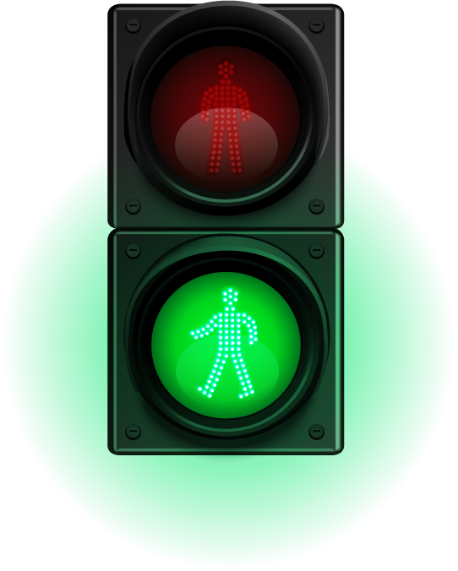
Networking Components
TRAFFIC LIGHT
Wi-Fi Router connects all devices wirelessly.
SBC Controller processes sensor data.
Server stores street data.
Laptop displays the data.
This demonstrates real IoT communication.
2025

Slide 10
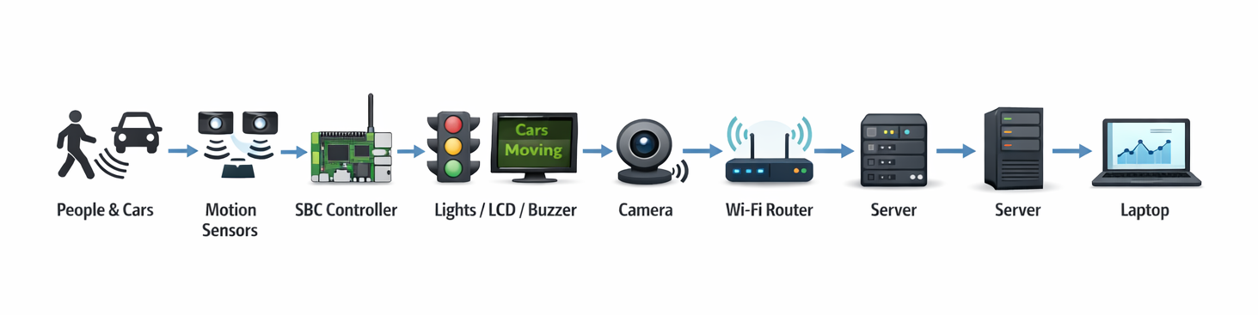
Data Flow :

Slide 11
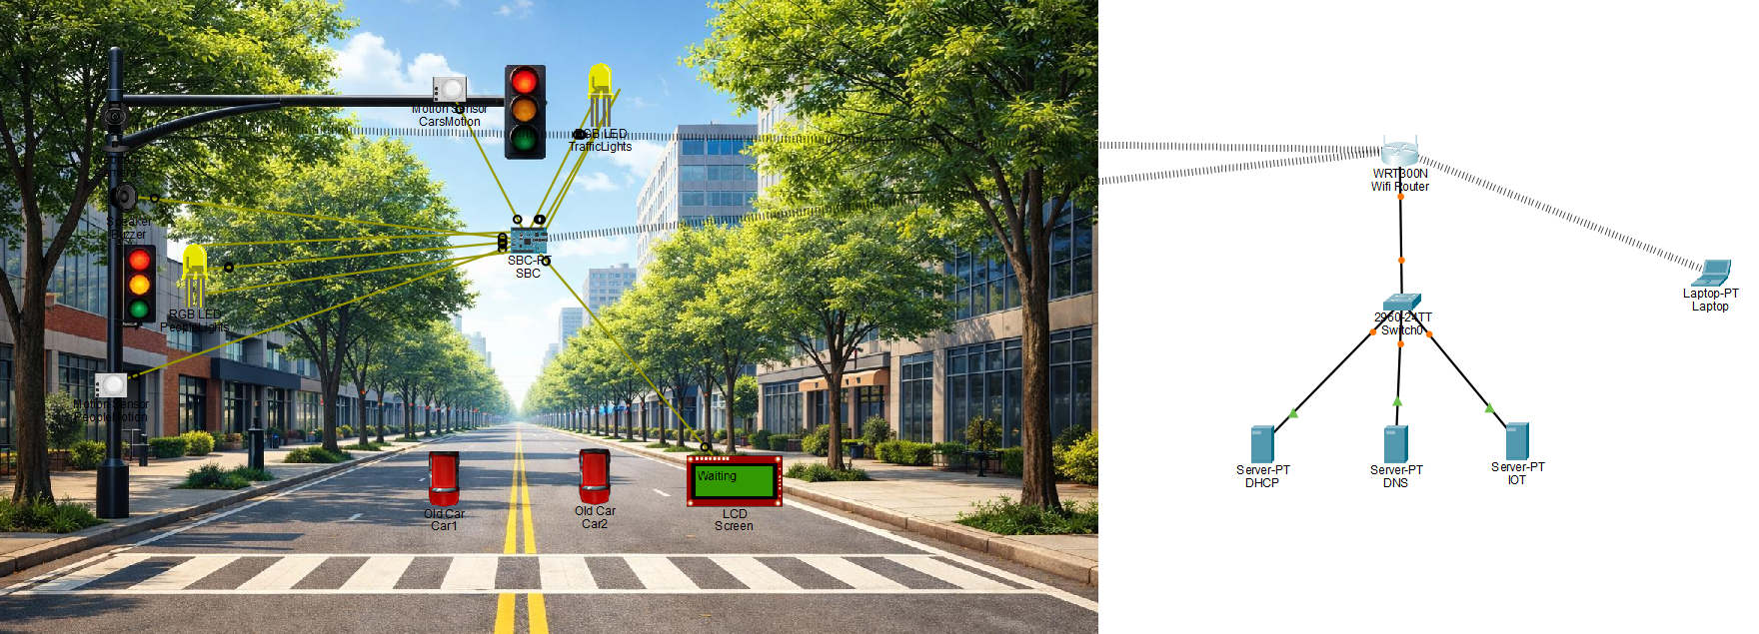

Slide 12
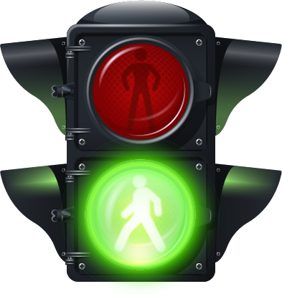
THANKS

